Slide 1
Wrexham Town & Community Council Forum
8th December 2016
An update from
Wrexham Public Services Board

Slide 2
Introduction
Guidance for Community Councils from the Well Being of Future Generations (Wales) Act
A Community Council representative on the Wrexham PSB
Update on the work of Wrexham Public Services Board (PSB) meeting their requirements of the Well Being of Future Generations (Wales) Act
Notes:
Introduce self and role of PSB support
Today 3 areas I want to cover

Slide 3
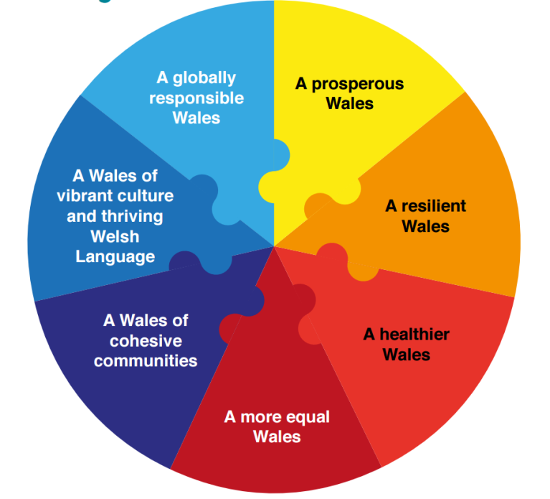
The Well Being of Future Generations (Wales) Act 2015
The process of improving the:
Economic
Social
Environmental
Cultural
well-being of Wales by taking action in accordance with the sustainable development principle aimed at achieving the well-being goals.
The sustainable development principle: Ensure the needs of the present are met without compromising the ability of future generations to meet their own needs. A public body must take into account:
Long-term
Involvement
Collaboration
Prevention
Integration
Notes:
Start with a quick reminder of what the WBFG Act aims to do:
Public bodies: (44)
Community Councils not listed:
Local authorities
Health boards
Public heath Wales
Fire and rescue
Natural resources Wales
Higher Education funding council for Wales
Arts council
Sports council
National library
National Museum

Slide 4
New Body: the PSB with collective duties:
www.wrexhampsb.org
Membership of the PSB:
Statutory: WCBC, BCUHB, NRW and NWFRS
Invited: North Wales Police, PCC, WG, Probation, AVOW
Other: Coleg Cambria, Glyndwr University
To improve the well-being of its area by:
Undertaking a well being assessment for Wrexham (By March 2017)
Agree a well being plan for Wrexham (By March 2018)
Publish an annual report on (ongoing from March 2019)
Notes:
An additional collective duty for the newly formed PSBs

Slide 5
Guidance for Community Councils from the Well Being of Future Generations (Wales) Act
SPSF 4: Collective Role (Community Councils)
Are you a Community Council with a gross income or expenditure of £200k or more for the 3 financial years 2015/16, 2016/17, 2017/18?
If yes: take reasonable steps towards meeting the objectives of Wrexham’s well being plan (to be published in March 2018) and publish an annual report (from March 2019) detailing progress
If no: still able to follow guidance for larger community councils but on a voluntary basis
PSB to encourage all community councils to get involved
Scrutiny request, Community Council rep on the PSB
Notes:
Several supporting statutory guidance on WBFG act including (1) above
In Wrexham over £200k - you will need to check this yourself if you think you maybe close to this level: Caia, Rhos and possibly Gwersyllt
All to get involved, clearly key stakeholders.
Would CC like to have a representative member on the PSB?

Slide 6
‘The Wrexham We Want’
Phase 1 – to gather information about the things that matter to local people and ways to address them to feed into the draft assessment
9th September to 24th October 2016

Slide 7
Purpose…
Baseline performance against well-being goals
Baseline performance against ways of working
Find out peoples’ future aspirations for Wrexham
Identify what organisations need to do to make them a reality
Explore what communities can contribute to make them a reality
Explore what the term community means to people
Explore which communities people feel they belong to

Slide 8
Methods…
‘Wrexham We Want’ webpage
Social media, press and direct messaging
Single question – ‘What do you want Wrexham to be?…’
Detailed online and paper survey
Town centre market stalls
Focus groups covering all protected characteristics
Professional stakeholders workshop
Wrexham County Borough Councillors workshop
Young people’s participatory research project

Slide 9
All Partners Involved…
…actively supporting carrying out the consultation
Notes:
While the Council agreed to lead on the consultation methods outlined on the previous slide
All partners agreed to actively participate in supporting carrying out the consultaion to maximise it’s success
This included…
Promoting and distributing the survey as widely as possible to ensure a good response rate
Carrying out workshops and focus groups where more appropriate to ensure effective engagement with all service users

Slide 10
Response…
900 people took part in total
Single question – 217 respondents
Detailed survey – 354 responses
Market stalls – 96 attendees
Focus groups – 175 participants
Stakeholder workshop – 33 attendees
Member workshop – 26 attendees
Notes:
900 people took part – does sound pretty impressive at first
But - when you break it down (see slide)
And also reflect on the results on the consultation, which we will come to next…
If I’m honest I don’t think we maximised the opportunity this consultation offered - to engage with the wide range of service users across all partners

Slide 11
Results Well-Being Goals…
Notes:
Respondents were asked to say how strongly they agree Wrexham is a place that reflects each of the well-being goals on a scale 1 to 10, where 1 is SD and 10 is SA
Baseline current position, to see where need to focus greatest effort across the plan, measure and monitor changes in perceived performance overtime
Respondents feel Wrexham still has a long way to go to achieve each of the well-being goals
‘Being a globally responsive place’ – goal furthest from achieving
‘Having a vibrant culture’ – goal closest to achieving
But – still low agreement score overall
Where scores are particularly close, the margin of error means the rank order of goals could vary slightly

Slide 12
Results Ways of Working…
Notes:
Respondents asked to say how strongly they agree that Wrexham public services practice each of the ways of working on a scale 1 to 10, where 1 is SD and 10 is SA
Baseline current position, to see where need to focus greatest effort across the plan, measure and monitor changes in perceived performance overtime
Respondents feel Wrexham still has a long way to go to achieve each of the ways of working
‘Prevention’ – way of working furthest from achieving
‘Integration and Collaboration’ – way of working closest to achieving
But – still low agreement score overall
Where scores are particularly close, the margin of error means the rank order of goals could vary slightly

Slide 13
Results Aspirations…
Aspiration Theme | Brief description | Count
Thriving town-centre | Regenerate town-centre, reduce empty shops, increase variety of shops, improve layout and have a mixed economy | 218
Tackle and reduce anti-social behaviour | Including drink, drugs, begging and homelessness | 91
Listen to and act on public opinion | Listen to the wants and needs of local people, take into account the interests of whole County Borough, improve Councillors/Politicians/Political Structures | 77
Make Wrexham attractive | Improve appearance and cleanliness | 62
More ‘things to do’ | Activities / events / festivals / cultural activities – and in particular for children and young people | 47
Encourage community spirit and pride | Encourage community spirit, empowerment and a sense of pride | 41
Improve public transport | Improve public transport - accessibility, availability and connections in and outside Wrexham | 41
Notes:
Respondents were asked ‘What would make Wrexham a better place for future generations?’
Analysed all the feedback to identify the main themes relating to respondents future aspirations for Wrexham
Over 44 themes identified in total – appendix 2
Table highlights those that came out as top priorities overall…

Slide 14
Thriving Town Centre…
Improvements needed:
Regenerating and revitalising the old town-centre; Reducing the number of empty shops; Improving the quality and variety of shops; Having a more mixed economy; Improving the town-centre layout
Barriers identified:
Poor Planning; Lack of vision: Not listening to public opinion; High business rates; Shop landlords; Poor town image; Lack of money to invest; People favouring neighbouring towns
PSB solutions suggested:
Reduce business rates and rents; Encourage large shops back to town centre; Make Eagles Meadow an entertainments complex; Listen to and work with local people, Have more police presence; Learn from other small towns
Community solutions suggested:
Very few felt there was anything they could do to contribute, however some suggested continuing to visit the town and support the shops and events, and others wanted to get involved in improving the town
Notes:
For each of these top priority aspirations, within the report you will find a breakdown of the improvements needed, barriers to improvement and suggested PSB and community solutions identified in relation to each theme, alongside any key issues for people with specific characteristics
We now need to continue this piece of work for each of the 44 aspiration themes identified
But if we take the thriving town centre as an example…
Thriving Town Centre theme was a key priority for the disability focus group, carers focus group, Portuguese focus group and at the stakeholder event it was a key priority for community councillors and the town centre forum

Slide 15
Results ‘Community’…
A community could be:
A collective of people
Where you live
It encompasses:
Coming together and getting involved
Helping, supporting, caring
Being diverse, inclusive, harmonious
Being friendly, neighbourly, socialising
It has a purpose:
Sharing common interests
Sharing common goals
Sharing values and beliefs
Improving something
Notes:
Interestingly one of the strong messages from the aspirations element of the consultation was that responses to the ‘what could you or your community contribute to make this a reality’ question were noticeably lacking
So it became really interesting when we started looking at the responses to the community element of the consultation, as when we asked people what the term community meant to them, in stark contrast, not only were there far more responses, but the content of those responses was really quite passionate
People want to feel part of a community, not only do they want to feel a sense of community spirit, but they want to feel empowered to pull together and make a difference
When asked what the term community meant it could be either…
It encompassed…
And importantly it was about having a sense of purpose…
When asked which communities people felt they belonged interesting to their majority named their village, with some saying Wrexham or their immediate neighbourhood
However a large number also said they didn’t feel they belonged to any community and they felt that the sense of community had been lost
Important message to take forward for the Wrexham Plan when you consider that community involvement is such a key part of the Act

Slide 16
Next Steps…
Dec 2016
Combine Phase 1 consultation findings with the Conwy data report to produce a rounded ‘draft’ well-being assessment
Jan to March 2017
Phase 2 consultaion – to gather feedback on the ‘draft’ well-being assessment
Further detailed analysis of Phase 1 findings to feed into the ‘final’ well-being assessment
Young peoples’ participatory research project to feed into ‘final’ well-being assessment
Identify significant, relevant PSB partner consultation findings, to feed into the ‘final’ well-being assessment, in order to highlight what matters to ALL service users
April to Aug 2017
Identify long list of priorities for the ‘draft’ well-being plan
Phase 3 consultation – to gather feedback on the long list of priorities
Sept 2017 to Feb 2018
Prepare ‘draft’ well-being plan
Phase 4 consultation – gather feedback on the ‘draft’ well-being plan (12 weeks)
March 2018 onwards
Publish ‘final’ well-being plan
Ongoing community ‘involvement’ in delivery plan
Ongoing community ‘involvement’ in monitoring and evaluation of plan

